Slide 1
Software Project Management
Chapter 5: Reviews

Slide 2
Review
A REVIEW IS ANY ACTIVITY IN WHICH A WORK PRODUCT is distributed to reviewers who examine it and give feedback
Reviews are useful not only for finding and eliminating defects, but also for gaining compromise among the project team and securing approval from stakeholders.

Slide 3
Inspections
An inspection is one of the most common sorts of review found in software projects.
The goal of the inspection is for all of the inspectors to reach consensus on a work product and approve it for use in the project.
The most important reason to inspect documents is to prevent defects.

Slide 4
Continue…
Inspections are easy to implement, and have an immediate effect on quality and consensus- building.
An effective inspection requires a well-chosen team, a moderator who is able to run the meeting, and an author who is willing to listen to criticism and fix the work product being inspected

Slide 5
Choose the Inspection Team
The job of the inspection team is to work with the author of the document in order to identify any defects.
The project manager must choose a team of 3 to 10 inspectors

Slide 6
Select a Moderator
This person must be able to objectively evaluate the work product being inspected and understand any issues that are raised during the inspection.
The moderator will also need to be able to control the meeting.
A good moderator will have sufficient technical background to understand the work product being inspected.

Slide 7
Continue…
The hardest part of the moderator’s job is to prepare the inspectors and the author for criticism of the work product.
To address this, the moderator must help the author understand the benefit of the criticism.
It’s the moderator’s job to make sure that the meeting does not become personal criticism, and that the comments are always constructive.
An effective way to do this is to focus the discussion on each defect and come up with a specific resolution.

Slide 8
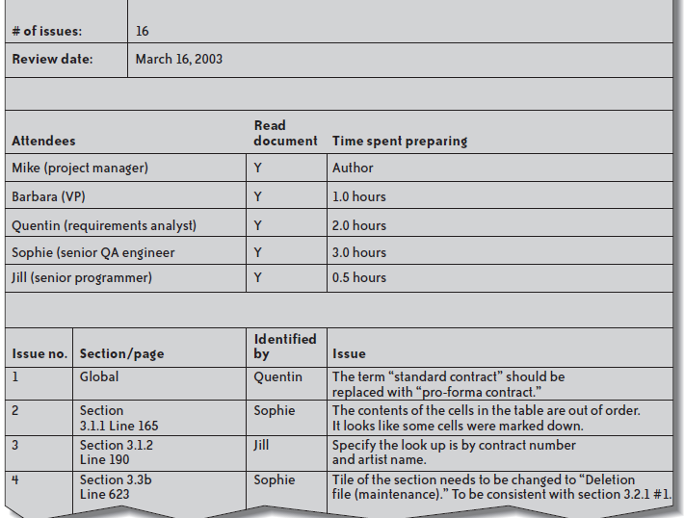
Inspection log

Slide 9
Inspect the Work Product
During the inspection meeting, a moderator leads the team page by page through a printed copy of the work product.
The purpose of the meeting is to identify and fix any defects.
Prior to the inspection meeting, each team member should be given a checklist to help her identify defects

Slide 10
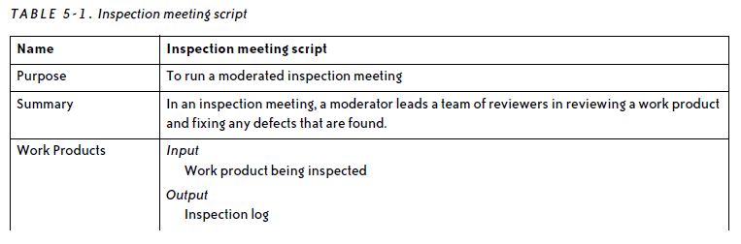

Slide 11
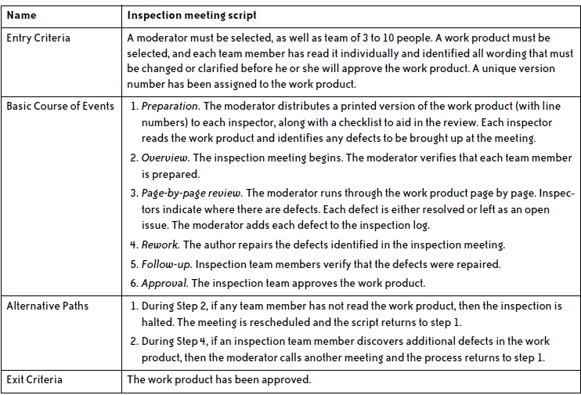

Slide 12
Manage the Author’s Expectations
A major challenge of the moderator role is keeping the author from altering the understanding of the document through discussion.
The purpose of the discussions is not to teach the inspectors about the project; it is to change the document so that the author and all of the inspectors will approve it.
The author should be prepared to listen to the inspection team discuss defects. It is tempting to get defensive and try to defend each defect.

Slide 13
Deskchecks
A deskcheck is a simple review in which the author of a work product distributes it to one or more reviewers.
In a deskcheck, the author sends a copy of the work product to selected project team members.
Unlike an inspection, a deskcheck does not produce written logs that can be archived with the document for later reference.
There is no follow-up meeting or approval process. It is simply a way for one team member to check another’s work.

Slide 14
Continue…
If a work product does not need approval by a team but is still a critical part of the software process, the project manager may require a deskcheck in order to ensure that it does not have defects.
The deskcheck usually relies entirely on the reviewer’s knowledge of the project and professional standards for the work product.
Deskchecks can be used as predecessors to inspections
Deskcheck can be useful to review a work product that is not meant to be inspected at all.

Slide 15
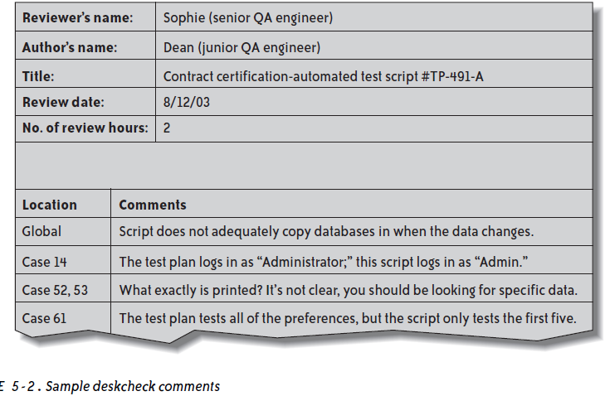

Slide 16
Walkthroughs
A walkthrough is an informal way of presenting a technical document in a meeting.
Walkthroughs are used when the author of a work product needs to take into account the perspective of someone who does not have the technical expertise to review the document.
This is an opportunity to brainstorm new or alternative ideas, and to check that each person understands the document that is being presented.

Slide 17
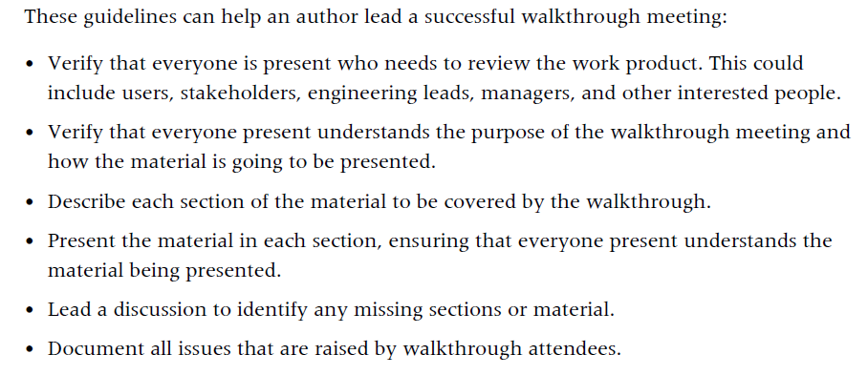

Slide 18
Code Reviews
A code review is a special kind of inspection in which the team examines a sample of code and fixes any defects in it.
In addition to helping teams find and fix bugs, code reviews are useful for both cross-training programmers on the code being reviewed and for helping junior developers learn new programming techniques

Slide 19
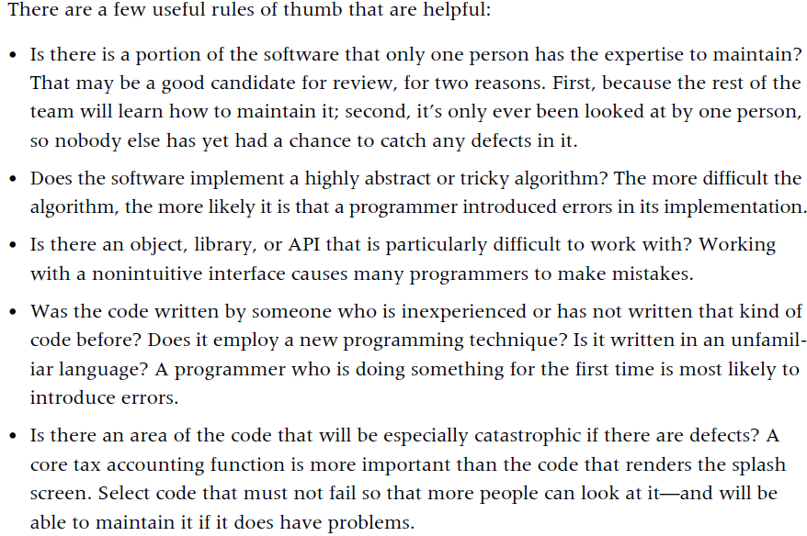
Select the Code Sample

Slide 20
Hold the Review Session
The team selection and preparation in a code review are similar to any other kind of inspection.
An inspection team of 3 to 10 people must be selected.
Before the meeting, the moderator distributes the code sample to each inspector, who does individual preparation exactly as in the inspection.
The main difference between a code review and any other kind of inspection is in the review session.

Slide 21
Continue…
The reader starts at the beginning of the code sample and announces the first block or logical unit.
She does not literally read the commands in the code; she simply gives a brief description (about one sentence) of the purpose of that block.
The moderator then updates the inspection log, and the inspection continues until the reader completes the code sample being inspected.

Slide 22
Continue…
Another important difference between code reviews and document inspections is that the code review is much more focused on detecting defects, and less on fixing them.
the moderator needs to be especially careful not to let the meeting turn into a problem-solving session.

Slide 23
Continue…
If a discussion looks like it will take more than three minutes or so, the moderator should stop the discussion and add it to the inspection log as an open issue
After the inspection meeting, the code author performs the rework and closes the open issues, and the moderator follows up with each of the inspectors and gains their approval.

Slide 24
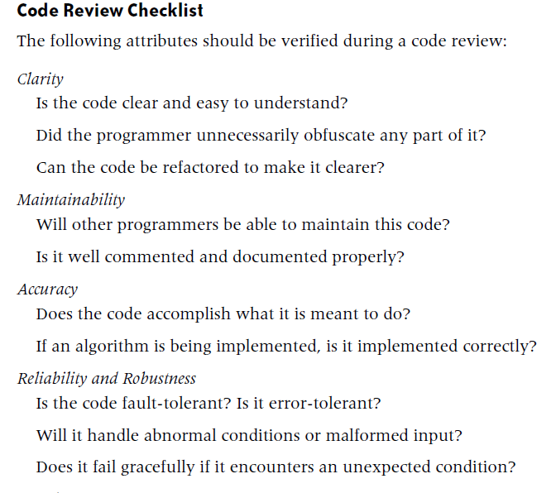

Slide 25
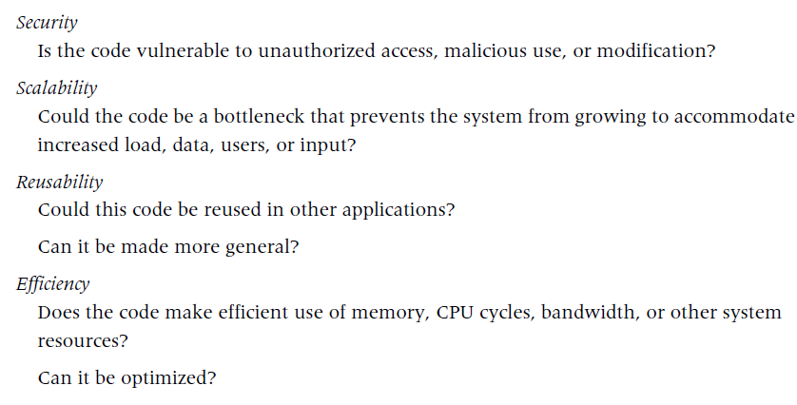

Slide 26
Benefits for the code review
One is that people learn how their teammates think about the code.
A good way to encourage this is to switch off code readers in each review, so every team member gets a chance to be a reader.
Reading code aloud and explaining it helps programmers think through problems.
Every programmer should be able to explain his ideas well; discussing code during a code review is good practice for that.

